Slide 1

Water Quality Monitoring Dashboard for Kutch Region
By: Kutch, Gujarat India Chapter
https://omdena.com/omdena-chapter-page-india/
Date - 1st December 2021

Slide 2
The Problem
According to UNICEF, One in nine people worldwide uses drinking water from unimproved and unsafe sources.
Water quality is one of the main challenges that societies are facing in the 21st century, threatening human health, limiting food production, reducing ecosystem functions, and hindering economic growth.
Water quality corrupts straightforwardly into ecological, financial, and social issues. The shortage of freshwater assets is expanding because of the disposal of large quantities of insufficiently treated, or untreated, wastewater into rivers, lakes, aquifers, and coastal waters.
Besides, recently rising pollutants like personal care products, pesticides, pharmaceuticals, and household chemicals, and changing environment patterns address another water quality challenge, with still unknown long-term impacts on human wellbeing and biological systems.
The 2030 Agenda and Sustainable Development Goals (SDGs) bring water quality issues to the bleeding edge of global activity by defining Goal 6 explicitly planning to “ensure availability and sustainable management of water and sanitation for all” to react to the squeezing difficulties presented by water quality issues.

Slide 3
The Problem
To develop a centralized dashboard with different water quality parameters for analysing, interpretation, and visualization in near real-time using Remote Sensing and AI for better decision making.
By developing a dashboard, decision-makers can easily identify if any parameter is not within the standard limits then immediate action can be taken for water treatment.
This dashboard will reinforce the abilities to monitor water quality more effectively and efficiently.

Slide 4
The Project Goals
Water Quality Indicator Dashboard for analysis, interpretation and visualization near Real time.
Compare real Water quality parameters with Standard Water quality limits

Slide 5
The Learning Outcomes
Satellite Images
Machine Learning
Time Series Analysis
Visualization
Preparing Dashboard

Slide 6

Timeline
Duration
4 weeks
Parameters identification of Water quality
Standard Water quality Parameters Literature Review
Satellite Images Availability
Time Series Analysis of Water Quality Parameters
Dashboard GUI Preparation
Dashboard Integration and Hosting on web
Week 1
Week 2
Week 3
Week 4
Future Work
Satellite Image Analysis
Water Quality Index and Parameters identification
Machine Learning Model
Notes:
Mention about observers and participants

Slide 7
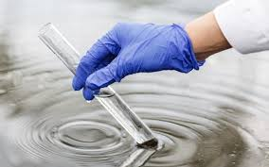
Week 1
Parameters identification of Water quality
Standard Water quality Parameters Literature Review
Satellite Images Availability

Slide 8
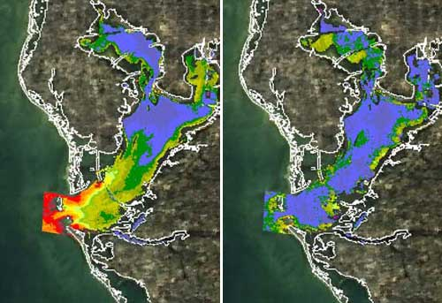
Week 2 - 3
Satellite Image Analysis
Water Quality Index and Parameters identification
Machine Learning Model

Slide 9
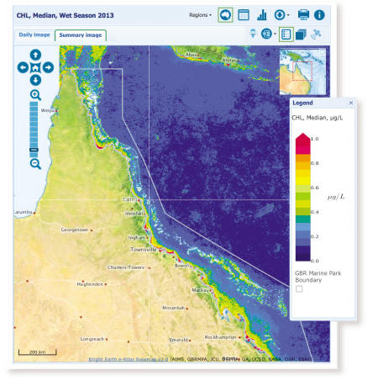
Week 3 - 4
Time Series Analysis of Water Quality Parameters
Dashboard GUI Preparation
Dashboard Integration and Hosting on web
Notes:
https://public.tableau.com/app/profile/feiviz/viz/Depression_15940430482600/Depression

Slide 10
Impact the Open Source Results Can Have
By developing a dashboard for water quality monitoring, decision-makers can easily identify if any parameter is not within the standard limits then immediate action can be taken for water treatment.
This dashboard will reinforce the abilities of decision-makers to monitor water quality more effectively and efficiently.
As the traditional in situ method is costly as well as time-consuming so using advanced geospatial technology water quality can be monitored spatially and temporally in near real- time and self-operating.

Slide 11
Learning & Development Workshops and/or Tutorials
Satellite Image Processing and GIS Google Earth Engine Applications
Other as per request by members

Slide 12
Thank you
keep in touch on slack

